Slide 1





Fit Benchmarking​
Patrick Odagiu
The University of Manchester

Slide 2



In this talk
How It Works
Some Results
The Future
1

Slide 3
Introduction
What is fitting?
2

Slide 4
Simplest Example of Fitting
“
Curve Fitting
curve fitting is the process of constructing a Curve, or a Mathematical Function, that has the best fit to a series of data points, possibly subject to constraints.
3

Slide 5
What is fitting?
Source: Christophe Dang Ngoc Chan
4

Slide 6
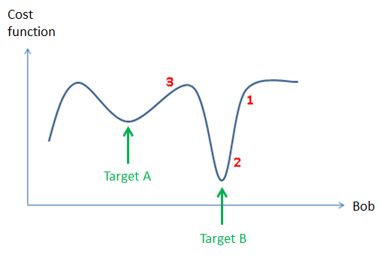
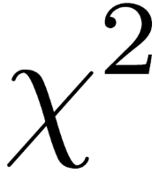
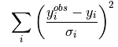
Chi-Squared
(can also be multidimensional)
5

Slide 7
FitBenchmarking
How do we benchmark?
6

Slide 8
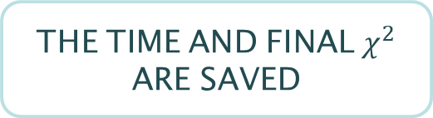
Benchmarking
USER PART
SELECT SOFTWARE
(OR ADD ONE)
SELECT MINIMIZERS FROM THAT SOFTWARE
SELECT A PROBLEM SET (OR ADD ONE)
FITBENCHMARKING PART
EACH MINIMIZER IS RAN AGAINST EACH PROBLEM
THE TIME AND FINAL $χ^{2}$ ARE SAVED
TABLES OF THE RESULTS ARE MADE, NORMALIZED TO THE BEST RESULT
7

Slide 9
Some Notes
Currently available problem sets are Neutron data problems (ENGINX, WISH) and NIST problems (very popular).
While these offer some variety, fitbenchmarking was designed to be extremely extensible (with extra minimizers and problems).
The current set of problems test the minimizers fairly extensively
(e.g. running each minimizer from two different starting points).
Currently adding new functionality! Feel free to try it!
8

Slide 10

This all seems pretty dry.
Why should I bother?

Slide 11
Reasons to Care
Maybe you are a scientist/organisation in need of efficiency.
Maybe you have designed a new minimizer and want to test it.
Here are three examples of use cases, which FitBenchmarking aims to address.
Maybe a problem seems impossible with the minimizer you are using and you want to explore others.
9

Slide 12



An example from the world of particle physics
Matrix Element Method
Great success!
See arXiv:1807.02876
11

Slide 13
Some Results
Some results obtained using ISIS data and the fit benchmarking code.
12

Slide 14




What is Benchmarked
NOW
FUTURE
And whatever you choose?
RALFit
13

Slide 15
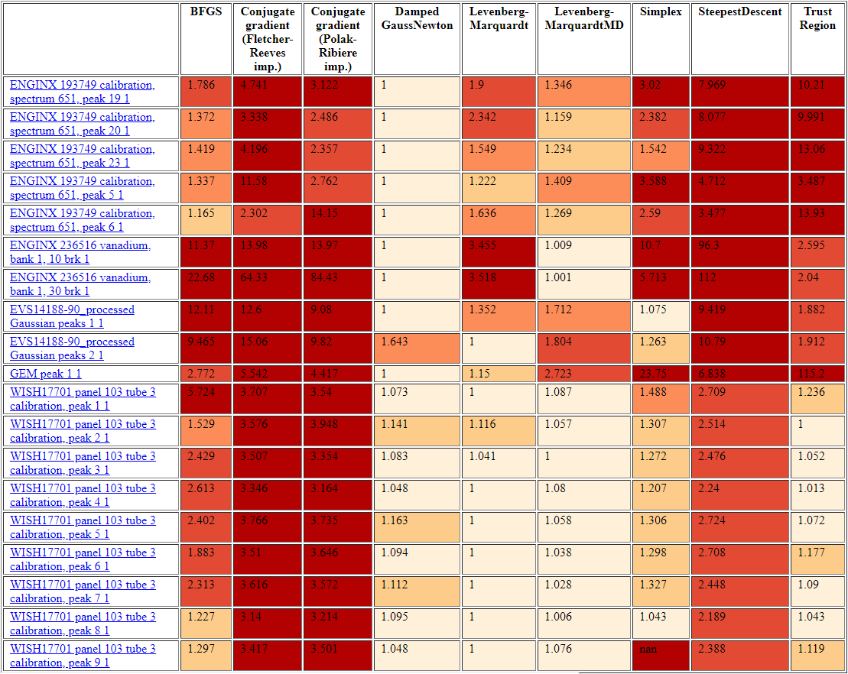
Example Table
Mantid 3.13.0
Time
14

Slide 16
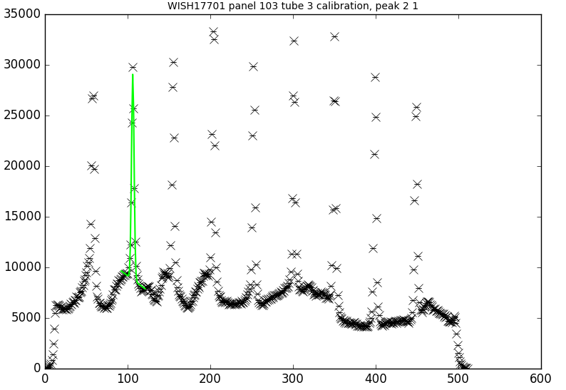
Example Result
LEVENBERG-MARQUARDT DOES PRETTY WELL MOST OF THE TIME
(HENCE IT IS THE DEFAULT MINIMIZER)
TRUST REGION IS FASTER BY
10 %
And just as accurate.
16

Slide 17
The Future
What does the future hold?
17

Slide 18

Widely Used
Aim to Become the Most Widely Used Framework for Benchmarking
18

Slide 19
Future Ints
RALFit
SasView and RALFit Integration
19

Slide 20

Paper
Paper coming soon
20

Slide 21
https://github.com/fitbenchmarking/fitbenchmarking
Thank You!
Questions?

